Slide 1
WEB ANOMALIES
Fall 2018 Final PROJECT

Slide 2
Agenda
IntRoduction
DESIGN
IMPLEMNTATION
CODE WALK THROUGH
QUESTIONS

Slide 3
INTRODUCTION
Now days any small or big organization heavily dependent on Website performance and availability.
Website can become unavailable due to various reason like backend data issues, issues with CMS.
All this issues results in page rank penalty by search engines and deter the brand name.
Detecting the problem as they occur before long term damages is key reuirement of today’s web infrastructure.

Slide 4
Continue….
To build the near real time anomalies detection framework for any website Web Server logs plays a very crucial role.
Our project aim is to take care of this problem and provide unique and reliable architecture solution.

Slide 5
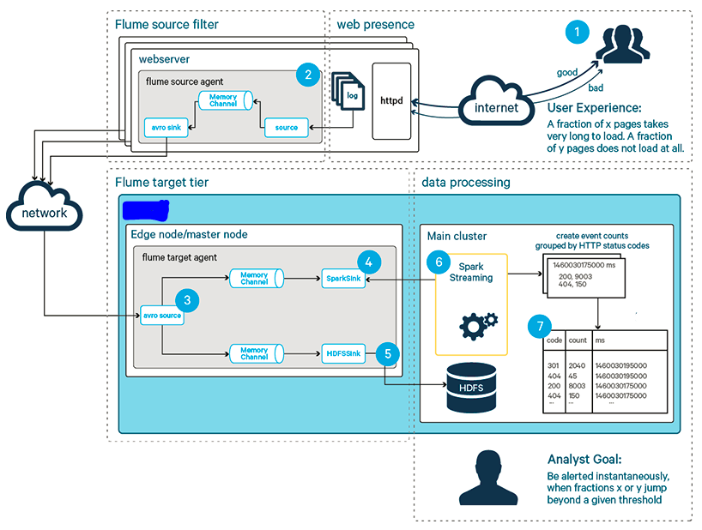
Design
The main design component of our solution architecture are logs, Flume, Spark Streaming and Cassandra as explained below.

Slide 6
Logs Files
The structure of log files as described below.
host making the request. A hostname when possible, otherwise the Internet address if the name could not be looked up.
timestamp in the format "DAY MON DD HH:MM:SS YYYY", where DAY is the day of the week, MON is the name of the month, DD is the day of the month, HH:MM:SS is the time of day using a 24-hour clock, and YYYY is the year. The timezone is -0400.
request given in quotes.
HTTP reply code.
bytes in the reply.

Slide 7
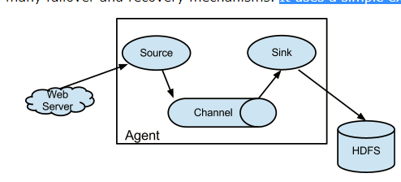
Flume
Flume is a distributed, reliable, and available service for efficiently collecting, aggregating, and moving large amounts of log data.
It has a simple and flexible architecture based on streaming data flows.
It is robust and fault tolerant with tunable reliability mechanisms and many failover and recovery mechanisms.
It uses a simple extensible data model that allows for online analytic application.

Slide 8
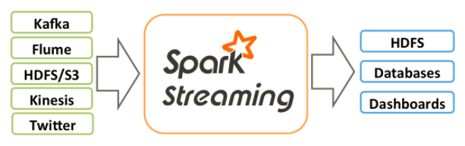
Spark Streaming
Spark streaming is an extension of the core spark API that enables scalable, high-throughput, fault-tolerant stream processing of live data streams.
Data can be ingested from many sources like Kafka, flume, kinesis, or TCP sockets, and can be processed using complex algorithms expressed.

Slide 9
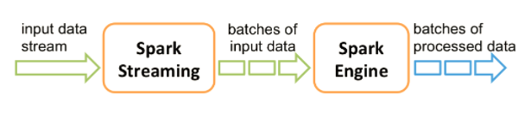
Spark Streaming
Internally, it works as follows. Spark streaming receives live input data streams and divides the data into batches, which are then processed by the spark engine to generate the final stream of results in batches.
Spark streaming provides a high-level abstraction called discretized stream or dstream, which represents a continuous stream of data.
Dstreams can be created either from input data streams from sources such as kafka, flume, and kinesis, or by applying high-level operations on other dstreams. Internally, a dstream is represented as a sequence of rdds.

Slide 10
Cassandra
Cassandra is a distributed database from apache that is highly scalable and designed to manage very large amounts of structured data.
It provides high availability with no single point of failure.
It is a type of NoSQL database.
Cassandra implements a dynamo-style replication model with no single point of failure, but adds a more powerful “column family” data model.
Cassandra is linearly scalable, i.e., It increases your throughput as you increase the number of nodes in the cluster. Therefore it maintains a quick response time.

Slide 11
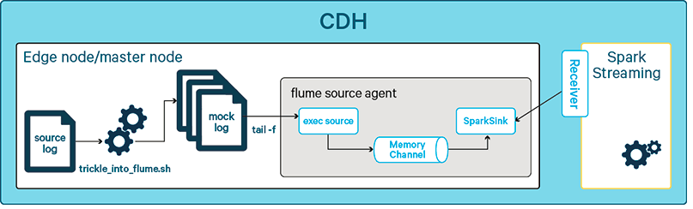
IMPLEMENTATION
We use a pull-based approach to connect spark streaming to flume, in which the spark streaming receiver uses transactions to obtain events from an org.Apache.Spark.Streaming.Flume.Sink.Sparksink.

Slide 12
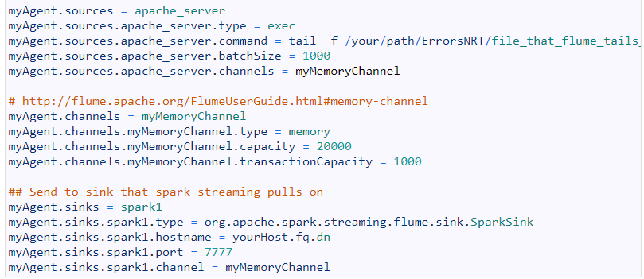
Continue….
We have setup the flume agent with one exec source, one memory channel, one spark sink which listen to new event using the flume agent.

Slide 13
Spark Streaming Flow
The spark streaming receiver gets individual events from the flume sink.
We create a subtype of dstream (flumeutils.Pollingstream), which creates a new micro batch every n seconds.
Spark streaming and spark transformations are done to:
Extract the HTTP status code from an event. This is achieved via a map function and custom extraction method (more on that below).
Every n seconds, count all status code occurrences, grouped by status code. We then combine batches of these aggregates marked with the creation time of the batch. This is achieved via a spark streaming transformation that combines windowing and reduce functionality called reducebykey and window (see below).

Slide 14
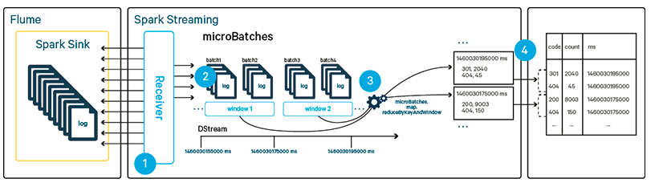
Continue….

Slide 15
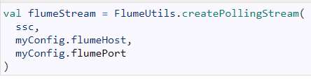
Micro Batches
Creating a discretized stream of events from the flume events via the following code.
The resulting dstream is a set of rdds that are managed by spark.

Slide 16

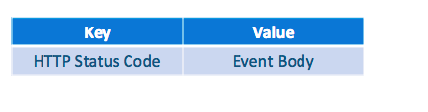
Continue….
We map each event to a function getstatuscode that extracts the status code from the event body and additionally extracts the full event body.

Slide 17
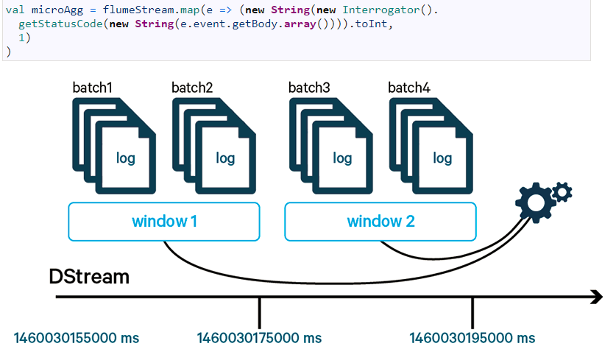
Counting and Windowing Events
The main feature of the streaming application, we want to count the events and group them by status codes. Similar to the well-known word-count example, we create key-value pairs of the form to represent a single event that can be easily counted in a successive step.

Slide 18
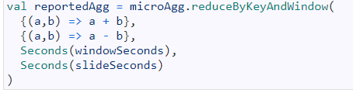
Continue….
The key-value pairs are then reduced by their key and counted.
We are using the special reduceByKeyAndWindow reduce function from the Spark Streaming package, which creates the windows in the desired format.
The new resulting DStream is called reportedAgg, since it is the aggregate that we report to Cassandra.

Slide 19
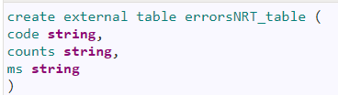
Storing to Cassandra Tables
To store the results in Cassandra, we create a destination table and then use spark streaming to continuously add data to the destination table at the end of each window.
The destination table is created as displayed in the below ddl statement.

Slide 20
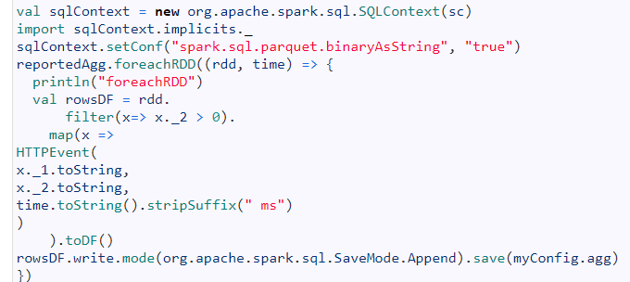
Continue….
The code segment below individually saves each RDD contained in the aggregated dstream to Cassandra table.

Slide 21
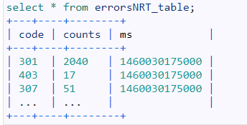
Querying Results
After we run the code we can see that we can see the data been added to our table.

Slide 22
Questions ?

